Slide 1
PREDICTION OF MENTAL HEALTH USING MACHINE LEARNING
Review 01
GUIDE: Dr. Balasaraswathi V R
Name: Gandla Pravallika
Reg no: 20BCE1277

Slide 2
INTRODUCTION
In the dynamic landscape of the modern workplace, the mental well-being of employees has emerged as a critical concern for organizations. The recognition of the intimate connection between mental health and overall productivity has prompted a shift in focus towards creating a supportive and conducive work environment. As businesses strive to optimize their workforce, predicting the necessity of mental health treatments for employees has become a key area of interest.
The importance of mental health in the workplace cannot be overstated. Stress, anxiety, and burnout are prevalent issues that can significantly impact an employee's performance, job satisfaction, and overall quality of life. Addressing these concerns proactively not only fosters a healthier workforce but also contributes to a more resilient and engaged team.
This paper aims to explore the factors contributing to the necessity of mental health treatments among employees and proposes a framework for predicting and addressing these needs. By understanding the indicators and risk factors associated with mental health challenges, organizations can implement targeted interventions, creating a more supportive and inclusive workplace culture.

Slide 3
INTRODUCTION
The objective is to develop a predictive model that considers both individual and organizational variables, providing insights into potential mental health challenges before they escalate. This proactive approach allows organizations to implement timely and effective interventions, ultimately enhancing employee well-being and organizational success.
Key components of this exploration will include an analysis of existing literature on workplace mental health, an examination of prevalent risk factors, and the development of a predictive framework that integrates both qualitative and quantitative data. By leveraging technology, such as surveys, data analytics, and artificial intelligence, organizations can gain valuable insights into the mental health status of their workforce.
As we delve into this critical aspect of workplace dynamics, it is essential to recognize the ethical considerations surrounding mental health data. Privacy, consent, and confidentiality must be prioritized to ensure the well-being and trust of employees. By predicting the necessity of mental health treatments, organizations can take proactive steps to create a workplace that prioritizes mental health, fosters resilience, and ultimately contributes to a more productive and satisfied workforce. This paper aims to provide a foundation for further research and practical strategies that organizations can implement to support the mental well-being of their employees.

Slide 4
STATEMENT OF THE PROBLEM
The current workplace mental health landscape faces challenges in predicting and addressing employees' mental health needs proactively. Limited predictive models, incomplete understanding of risk factors, underutilization of technology, ethical concerns, inconsistent organizational support, and stigma contribute to the gap. This research seeks to develop a comprehensive framework that integrates predictive models, technology, and ethical considerations to bridge these gaps, fostering a proactive approach to mental health in the workplace and ensuring timely interventions for employee well-being.

Slide 5
BACKGROUND
The workplace's evolving dynamics underscore the critical importance of mental health, yet a lack of proactive strategies hinders effective support for employees. With a focus on reactive measures, existing approaches fail to address the complexities of mental well-being. The need for a comprehensive framework arises from limited predictive models, an incomplete understanding of risk factors, underutilization of technology, ethical concerns, inconsistent organizational support, and persistent stigma. This research stems from a recognition that a proactive and integrated approach is essential to create resilient, supportive work environments that prioritize and predict mental health needs, ultimately benefiting both individuals and organizations.

Slide 6
Context:
In the contemporary workplace, the significance of mental health is increasingly acknowledged. The rapid pace of change, high-performance expectations, and diverse work environments contribute to stress and mental health challenges among employees. This context necessitates a deeper understanding of predictive models and interventions to proactively address mental health needs.
Significance of Study:
This research holds substantial importance in filling critical gaps within the existing landscape. By developing a comprehensive predictive framework, it aims to equip organizations with tools to anticipate and manage mental health challenges. The study's findings can guide the implementation of proactive measures, leveraging technology ethically, and fostering supportive workplace cultures. Ultimately, the research contributes to improved employee well-being, increased organizational resilience, and enhanced productivity in the evolving landscape of work.

Slide 7
LITERATURE REVIEW

Slide 8
S.No | TITLE AND AUTHORS | SUMMARY | RESULT AND OBSERVATIONS
1. | Machine Learning Techniques for Stress Prediction in Working Employees Author: U Srinivasulu Reddy, Year: 2019 | This paper applies machine learning to analyze stress patterns in working IT professionals. Using data from the OSMI mental health survey, various machine learning techniques were employed, with boosting showing the highest accuracy. Decision Trees identified gender, family history, and health benefits as influential stress factors. | Bagging exhibited the highest accuracy among the models, with Decision Trees revealing key stress influencers as gender, family history, and workplace health benefits.
2. | Deep Learning Based Stress Prediction From Offline Signatures Authors: Hakan Yekta Yatbaz, Meryem Erbilek, Year: 2020 | This study introduces a deep learning approach for stress prediction from offline signatures, utilizing architectures like AlexNet, ResNet, and DenseNet. The empirical study achieved a prediction accuracy of approximately 77%. | The study presents the first experimental deep learning model for stress prediction from offline signatures, achieving an empirical accuracy of around 77%.
3. | Deep Learning For Time Averaged Wall Shear Stress Prediction In Left Main Coronary Bifurcations Authors: Ramtin Gharleghi, Gihan Samarasinghe, Arcot Sowmya, Susann Beier, Year: 2020 | Proposing a deep learning approach, this paper predicts time-averaged wall shear stress (TAWSS) in coronary arteries based on vessel geometry. Achieving good accuracy, the model offers a faster alternative to computational fluid dynamic simulations for cardiovascular disease risk prediction. | The deep learning model accurately predicts TAWSS, providing results comparable to simulations but with significantly faster computation time.

Slide 9
4. | A Deep Learning Approach Replacing the Finite Difference Method for In situ Stress Prediction Authors: Wenli Gao, Xinming Lu, Yanjun Peng, And Liang Wu, Year: 2020 | Introducing the enhance-and-split feature capsule network embedded in fully convolutional neural networks (ES-Caps-FCN), this paper proposes a deep learning architecture for predicting in situ stress in geotechnical engineering. The novel approach outperforms classical methods in accuracy and computational efficiency. | ES-Caps-FCN demonstrates stability, convergence, and superior accuracy compared to classical methods, showcasing its potential as a fast and accurate surrogate for in situ stress prediction.
5. | Personalized Multitask Learning for Predicting Tomorrow’s Mood, Stress, and Health Authors: Sara Taylor, Natasha Jaques, Ehimwenma Nosakhare, Akane Sano, and Rosalind Picard, Year: 2020 | This paper employs Multitask Learning (MTL) techniques to train personalized machine learning models for predicting individual mood, stress, and health. MTL deep neural networks, Multi-task Multi-Kernel learning, and a Hierarchical Bayesian model are compared, demonstrating significant performance improvements over traditional methods. | MTL techniques, especially MTL deep neural networks, prove highly effective in providing personalized, actionable insights for predicting future mood, stress, and health.
6. | An Integrated Multimodal Attention-Based Approach for Bank Stress Test Prediction Authors: Farid Razzak, Fei Yi, Yang Yang, Hui Xiong, Year: 2019 | This paper proposes an Integrated Multimodal Bank Stress Test Prediction (IMBSTP) model framework, integrating an economic conditions estimator and a bank capital & loss forecaster. The model leverages generative models and dual-attention recurrent neural networks for predicting stress test measures. | IMBSTP demonstrates effectiveness in predicting stress test measures, showcasing the potential of integrated multimodal approaches in financial risk assessment.

Slide 10
7. | Accurate Stress Assessment based on functional Near Infrared Spectroscopy using Deep Learning Approach Authors: Mahya Mirbagheri, Ata Jodeiri, Naser Hakimi, Vahid Zakeri, Seyed Kamaledin Setarehdan, Year: 2019 | Utilizing functional Near-Infrared Spectroscopy (fNIRS) signals, this study proposes a deep learning system for stress assessment. The model achieves an accuracy of 88.52%, outperforming existing methods and providing stable predictions with lower variation. | The proposed deep learning system proves effective in fNIRS-based stress classification, offering higher accuracy and stability compared to existing methods.
8. | Visual Impairment and Mental Health: Unmet Needs and Treatment Options Authors: Docia L Demmin & Steven M Silverstein, Year: 2020 | This review explores the mental health needs of visually impaired individuals, emphasizing the significant impact of vision loss on quality of life and mental health. It addresses the unmet needs and potential treatment options for this population. | The review highlights the substantial mental health challenges faced by visually impaired individuals, emphasizing the need for tailored treatment options.
9. | Mental Health Prevention and Promotion—A Narrative Review Authors: Vijender Singh, Akash Kumar, and Snehil Gupta, Year: 2021 | This narrative review synthesizes existing literature on mental health promotion and prevention strategies, emphasizing novel interventions. It discusses challenges, opportunities, and future directions for mental health care across different resource settings. | The review underscores the effectiveness of various mental health promotion and prevention interventions, urging the need for comprehensive strategies in diverse settings.

Slide 11
10. | Mental Health Prediction Using Machine Learning: Taxonomy, Applications, and Challenges Authors: Jetli Chung1and Jason Teo, Year: 2021 | Conducting a systematic review, this paper categorizes machine learning approaches in predicting mental health problems based on different disorders. It discusses challenges, limitations, and future directions for applying machine learning in mental health. | The review categorizes machine learning applications in predicting various mental health problems, highlighting challenges and offering recommendations for future research.
11. | Machine learning model to predict mental health crises from electronic health records Authors: Roger Garriga, Javier Mas, Semhar Abraha, Jon Nolan, Oliver Harrison, George Tadros & Aleksandar Matic, Year: 2022 | Developing a machine learning model using electronic health records, this study predicts mental health crises over 28 days. Achieving clinical value, the model demonstrates sensitivity of 58% at a specificity of 85%. | The machine learning model shows promise in continuously predicting mental health crises, offering clinical value in managing caseloads or mitigating risks in 64% of cases.
12. | Prioritizing the Mental Health and Well-Being of Healthcare Workers: An Urgent Global Public Health Priority Authors: Lene E. Søvol, John A. Naslund, Antonis A. Kousoulis, Shekhar Saxena, M. Walid Qoronfleh, Christoffel Grobler, Lars Münter, Year: 2022 | Focusing on the mental health of healthcare workers during the COVID-19 pandemic, this article emphasizes the urgent need to prioritize and protect their well-being. It provides evidence-based recommendations for systemic changes to support healthcare workers. | The paper highlights the mental health challenges faced by healthcare workers during public health emergencies, calling for systemic changes and policy recommendations.

Slide 12
13. | Methods in predictive techniques for mental health status on social media: a critical review Authors: Stevie Chancellor & Munmun De Choudhury, Year: 2020 | Conducting a systematic literature review, this paper critically evaluates predictive techniques for mental health status on social media. It identifies challenges and provides recommendations for standardizing research in this interdisciplinary field. | The review identifies challenges in constructing valid predictive models for mental health status on social media, offering recommendations for future research and collaboration.
14. | Treatment outcomes for depression: challenges and opportunities Authors: Pim Cuijpers, Argyris Stringaris, Miranda Wolpert, Year: 2020 | Highlighting ten key statistics related to depression treatment outcomes, this Comment emphasizes the limitations in current treatment approaches. It suggests the need for improved methods and personalized care. | The paper emphasizes the need for improvement in depression treatment outcomes, suggesting a focus on personalized care and addressing existing limitations.
15. | Deep learning in mental health outcome research: a scoping review Authors: Chang Su, Zhenxing Xu, Jyotishman Pathak & Fei Wang, Year: 2020 | Reviewing the state-of-the-art in applying deep learning to mental health outcome research, this paper categorizes studies into diagnosis, genetics analysis, vocal/visual expression, and risk estimation using social media data. | The review categorizes deep learning applications in mental health research, providing insights into the potential of these techniques in improving diagnosis and treatment.

Slide 13

PROBLEM STATEMENT
Stress could be due to various problems in an individual’s life. It could be due to the factors like work pressure, parental or society pressure, attempting to achieve unrealistic goals, school activities pressure or psychological trauma. We focus on three psychological concerns - Depression Disorder, Anxiety Disorder & Sleep Disorder. Depression disorders can be described as different mood swings like anger or sadness which may cause stress. Anxiety disorders like feeling of nervousness or worry or a concern of something uncertain can happen may lead to stress of an individual. Sleep disorders like insomnia also causes stress for an individual.

Slide 14
RESEARCH CHALLENGES
Research challenges include navigating the evolving landscape of remote work, where the unique stressors and mental health implications are not fully understood. Integrating advanced technologies, such as predictive analytics, poses implementation challenges, requiring organizations to overcome barriers related to data privacy and employee consent. Industry-specific variations in risk factors demand nuanced approaches, and addressing intersectional perspectives introduces complexity. Developing proactive organizational cultures requires a shift in mindset and practices. Conducting comprehensive longitudinal studies is challenging due to resource constraints. The underrepresentation of small and medium enterprises in research hampers understanding their distinct mental health dynamics. Lastly, establishing effective mental health literacy programs necessitates overcoming barriers to implementation and sustainability.

Slide 15
RESEARCH OBJECTIVE
The research aims to develop a comprehensive framework for predicting the necessity of mental health treatments among employees in the contemporary workplace. The primary objectives include integrating advanced technologies, such as predictive analytics, to enhance the accuracy of predictive models. It seeks to identify industry-specific risk factors, considering the unique challenges posed by remote work, and address the intersectionality of individual identities in mental health dynamics. The research aims to foster proactive organizational cultures, emphasizing the importance of organizational commitment and values. Additionally, it seeks to conduct longitudinal studies to understand the evolving nature of mental health needs. Ultimately, the research aims to bridge existing gaps, providing actionable insights for organizations to proactively support employee well-being.

Slide 16
METHODOLOGY
A. Modules/Algorithms/Functionalities/Protocols:
Predictive Analytics Module: Utilizing algorithms to analyze historical and real-time data to predict potential mental health needs.
Surveys and Questionnaires Protocol: Employing standardized tools for collecting subjective data on mental health status and stressors.
Technology Integration Functionality: Incorporating IT systems to streamline data collection, ensuring efficiency and accuracy.
B. Data Collection Approaches/Strategies:
a) Advantage of Strategy:
Predictive Analytics: Provides real-time insights, allowing proactive interventions.
Surveys and Questionnaires: Captures subjective experiences, offering a comprehensive view of individual well-being.
Technology Integration: Enhances data accuracy, reduces manual errors, and facilitates seamless collection.

Slide 17
METHODOLOGY
b) Limitation of Strategy:
Predictive Analytics: Relies on historical data, may not capture sudden changes or individual nuances.
Surveys and Questionnaires: Subject to response bias and may not capture real-time fluctuations.
Technology Integration: Initial costs and potential resistance to technology adoption within the workforce.
c) Potential Risk:
Predictive Analytics: Risk of misinterpretation or bias if not regularly calibrated.
Surveys and Questionnaires: Risk of incomplete or inaccurate responses due to subjective interpretation.
Technology Integration: Data security risks, potential technical glitches, and resistance from employees.

Slide 18
METHODOLOGY
d) Ethical Issues about collection upon the Subjects/Participants:
Informed Consent: Ensuring participants understand the purpose and implications of data collection.
Privacy Concerns: Safeguarding participant data to prevent unauthorized access or misuse.
Anonymity: Protecting participant identities to encourage honest responses.
C. Data Analysis Approaches:
Quantitative Analysis: Employing statistical methods to analyze survey responses and quantitative data from predictive analytics.
Qualitative Analysis: Utilizing thematic analysis for subjective data from surveys to extract meaningful insights.
Integration of Results: Correlating quantitative and qualitative findings for a comprehensive understanding of mental health needs.

Slide 19
PROPOSED SYSTEM
The proposed Comprehensive Workplace Mental Health Management System integrates predictive analytics, surveys, and technology to offer a proactive approach to employee well-being. Leveraging machine learning algorithms, standardized surveys, and IT systems, the system predicts mental health needs, captures diverse experiences, and ensures efficient data collection. A centralized database and real-time monitoring dashboard enhance accessibility and immediate awareness. The system prioritizes data privacy and ethics, ensuring compliance with standards and building participant trust. Integration of results and an intervention recommendation system provide a holistic interpretation, facilitating informed decision-making and personalized mental health support.

Slide 20
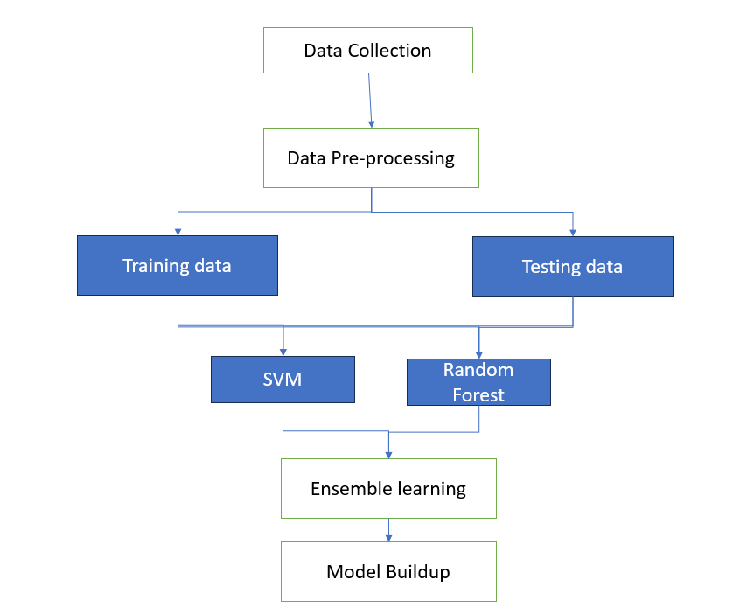
PROPOSED SYSTEM DIAGRAM

Slide 21
LIST OF MODULES
Data Collection
Data Pre-processing
Feature Extraction
Machine Learning Algorithms
Model Training
Validation and Testing
Real-time Integration

Slide 22
Data Collection:
  It gathers diverse information, including academic records, lifestyle details, and psychosocial assessments. Surveys and interviews may be employed to collect subjective insights. This module ensures the inclusion of varied factors influencing mental health, facilitating a holistic analysis. Data integrity is maintained through ethical considerations, emphasizing participant consent and privacy. By incorporating a range of relevant variables, this module lays the foundation for robust machine learning models, contributing to the accurate prediction of mental health levels and enabling targeted interventions to enhance the well-being of employees.
Data Pre-processing:
  The Data Pre-processing Module begins by cleaning the dataset, addressing missing values, outliers, and inconsistencies to ensure data quality. Feature scaling and normalization techniques are applied to standardize variable ranges, preventing bias in model training. Categorical variables may be encoded, and irrelevant features are removed through feature selection methods, enhancing model efficiency. The module also handles data transformation, such as converting categorical variables into numerical formats. A well-structured Data Pre-processing Module is essential for refining the dataset, minimizing noise, and optimizing it for subsequent analysis, ultimately contributing to the accuracy and reliability of employees.

Slide 23
Feature Extraction:
It employs advanced techniques to extract informative features from the dataset, emphasizing key aspects of academic, lifestyle, and psychosocial factors. Methods such as Principal Component Analysis (PCA) can be applied to reduce dimensionality and enhance the discriminative power of the model. This module aids in prioritizing the most influential factors for prediction of metal health, promoting efficiency and interpretability. By refining the feature set, this module contributes to the overall effectiveness of machine learning algorithms, fostering accurate predictions and facilitating targeted interventions to support the well-being of employees.
Machine Learning Algorithms:
The random forest algorithm is an extension of the bagging method as it utilizes both bagging and feature randomness to create an uncorrelated forest of decision trees. Feature randomness, also known as feature bagging or “the random subspace method” generates a random subset of features, which ensures low correlation among decision trees. This is a key difference between decision trees and random forests. While decision trees consider all the possible feature splits, random forests only select a subset of those features.

Slide 24
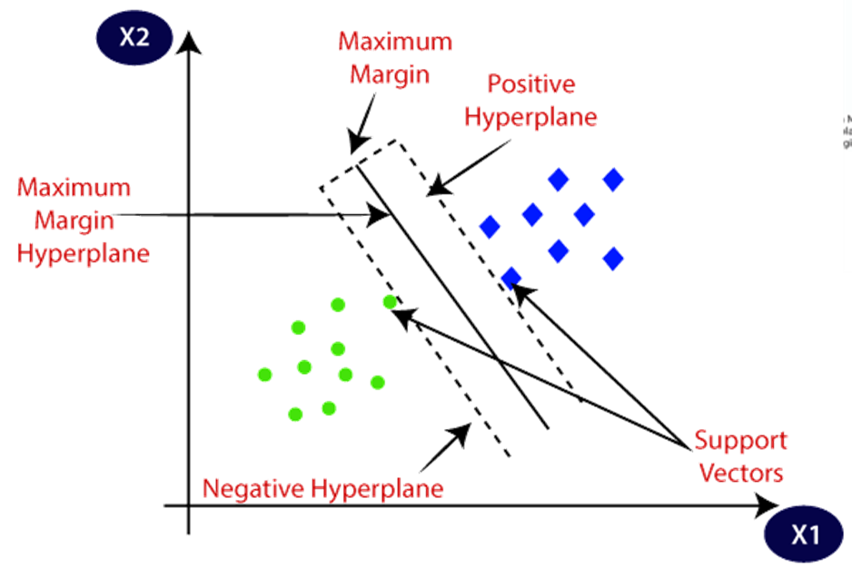
SVM :
Support Vector Machine or SVM is one of the most popular Supervised Learning algorithms, which is used for Classification as well as Regression problems. However, primarily, it is used for Classification problems in Machine Learning. The goal of the SVM algorithm is to create the best line or decision boundary that can segregate n-dimensional space into classes so that we can easily put the new data point in the correct category in the future. This best decision boundary is called a hyperplane.
SVM chooses the extreme points/vectors that help in creating the hyperplane. These extreme cases are called as support vectors, and hence algorithm is termed as Support Vector Machine. Consider the below diagram in which there are two different categories that are classified using a decision boundary or hyperplane:

Slide 25

PERFORMANCE MATRICES:
Data was divided into two portions, training data and testing data, both these portions consisting 70% and 30% data respectively. All these two algorithms were applied on same dataset using Enthought Canopy and results were obtained.
Predicting accuracy is the main evaluation parameter that we used in this work. Accuracy can be defied using equation. Accuracy is the overall success rate of the algorithm.
CONFUSION MATRIX:
It is the most commonly used evaluation metrics in predictive analysis mainly because it is very easy to understand and it can be used to compute other essential metrics such as accuracy, recall, precision, etc. It is an NxN matrix that describes the overall performance of a model when used on some dataset, where N is the number of class labels in the classification problem.

Slide 26
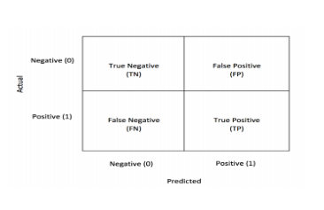
All predicted true positive and true negative divided by all positive and negative. True Positive (TP), True Negative (TN), False Negative (FN) and False Positive (FP) predicted by a algorithms are presented in table.
Many measures are available for assessing system performance. Typically tests after tests are used for assessing intrusion detection.
True positive (TP)
True Negative (TN)
False-positive (FP)
False-negative (FN)

Slide 27
Model Training:
It utilizes a diverse dataset during training, the chosen algorithms, such as Support Vector Machines, learn to associate input features with corresponding to mental health. The module incorporates techniques like cross-validation to optimize model parameters and prevent overfitting. Ethical considerations ensure responsible handling of sensitive data, safeguarding participant privacy. The effectiveness of the prediction model hinges on the accuracy attained during this training phase, making it crucial for providing reliable insights and supporting interventions to enhance the well-being of employees.
Validation and Testing:
The Validation and Testing Module ensures the reliability and generalizability of machine learning models. Following model training, this module involves validating the model on a separate dataset not used during training, using techniques like cross-validation to assess performance robustness. It measures the model's ability to generalize to new data, providing insights into its predictive power. Rigorous testing against diverse scenarios and datasets is conducted to evaluate the model's accuracy, sensitivity, and specificity.

Slide 28
What to be done next?
Implementing the proposed Comprehensive Workplace Mental Health Management System.
Developing and integrating the predictive analytics and technology modules. Establish a secure centralized database.

Slide 29
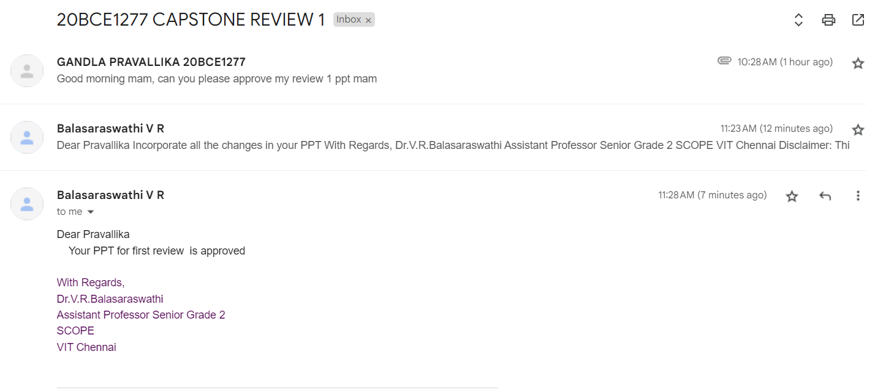
GUIDE APPROVAL SNAPSHOT

Slide 30
RESEARCH PAPER STATUS
I have recently initiated the writing of my research paper, focusing on incorporating the findings from the literature survey. At this early stage, my document primarily outlines the outcomes of the literature review. I plan to introduce the methodology and other sections as I progress with the implementation of the research."

Slide 31
REFERENCES
[1] U SRINIVASULU REDDY”Machine Learning Techniques for Stress Prediction in Working Employees”,2019
[2] HakanYektaYatbaz, MeryemErbilek,”Deep Learning Based Stress Prediction From Offline Signatures”,2020
[3] RamtinGharleghi, GihanSamarasinghe, ArcotSowmya, Susann Beier,”Deep Learning For Time Averaged Wall Shear Stress Prediction In Left Main Coronary Bifurcations”,2020
[4] Wenli Gao, Xinming Lu, Yanjun Peng, And Liang Wu,”A Deep Learning Approach Replacing the Finite Difference Method for In situ Stress Prediction”,2020
[5] Sara Taylor, Natasha Jaques, EhimwenmaNosakhare, Akane Sano, and Rosalind Picard”Personalized Multitask Learning for Predicting Tomorrow’s Mood, Stress, and Health”,2020
[6] FaridRazzak, Fei Yi, Yang Yang, Hui Xiong”An Integrated Multimodal Attention-Based Approach for Bank Stress Test Prediction”,2019
[7] MahyaMirbagheri, Ata Jodeiri, NaserHakimi, VahidZakeri, SeyedKamaledinSetarehdan”MahyaMirbagheri, Ata Jodeiri, NaserHakimi, VahidZakeri, SeyedKamaledin Setarehdan”,2019

Slide 32
REFERENCES
[8] U SRINIVASULU REDDY”Machine Learning Techniques for Stress Prediction in Working Employees”,2019
[9] HakanYektaYatbaz, MeryemErbilek,”Deep Learning Based Stress Prediction From Offline Signatures”,2020
[10] RamtinGharleghi, GihanSamarasinghe, ArcotSowmya, Susann Beier,”Deep Learning For Time Averaged Wall Shear Stress Prediction In Left Main Coronary Bifurcations”,2020
[11] Wenli Gao, Xinming Lu, Yanjun Peng, And Liang Wu,”A Deep Learning Approach Replacing the Finite Difference Method for In situ Stress Prediction”,2020
[12] Sara Taylor, Natasha Jaques, EhimwenmaNosakhare, Akane Sano, and Rosalind Picard”Personalized Multitask Learning for Predicting Tomorrow’s Mood, Stress, and Health”,2020
[13] FaridRazzak, Fei Yi, Yang Yang, Hui Xiong”An Integrated Multimodal Attention-Based Approach for Bank Stress Test Prediction”,2019
[14] MahyaMirbagheri, Ata Jodeiri, NaserHakimi, VahidZakeri, SeyedKamaledinSetarehdan”MahyaMirbagheri, Ata Jodeiri, NaserHakimi, VahidZakeri, SeyedKamaledin Setarehdan”,2019
[15] RamtinGharleghi, GihanSamarasinghe, ArcotSowmya, Susann Beier,”Deep Learning For Time Averaged Wall Shear Stress Prediction In Left Main Coronary Bifurcations”,2020
[16] Wenli Gao, Xinming Lu, Yanjun Peng, And Liang Wu,”A Deep Learning Approach Replacing the Finite Difference Method for In situ Stress Prediction”,2020
[17] Sara Taylor, Natasha Jaques, EhimwenmaNosakhare, Akane Sano, and Rosalind Picard”Personalized Multitask Learning for Predicting Tomorrow’s Mood, Stress, and Health”,2020

Slide 33
THANK YOU

